Slide 1
Product Recommendation using NLP on Amazon Customer Reviews
Amine Hamane
09/03/2023

Slide 2
Introduction
In today's online shopping landscape, consumers are overwhelmed by the numbers of product choices available to them. Making an informed decision becomes a challenging task, given the sheer volume of products and accompanying reviews. This project aims to simplify the decision-making process by finding the best Amazon product that aligns with specific features a consumer is looking for.
By leveraging Natural Language Processing (NLP) and web development technologies, this project sifts through thousands of Amazon reviews to recommend the most suitable product based on user-defined criteria.

Slide 3
Table of Contents
1. Data Collection
2. Data Cleaning
3. Creating the NLP Model
4. Creating a Flask Web App
5. Results

Slide 4
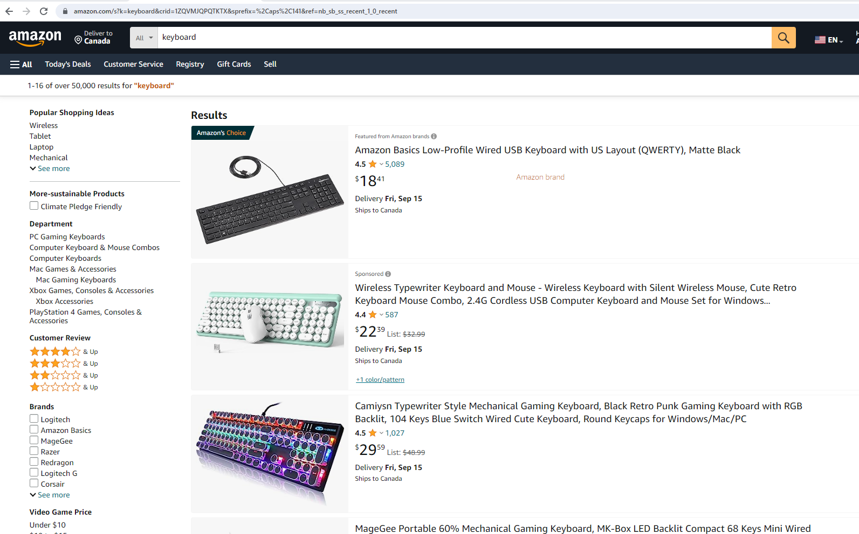






Data Collection product search page
Data Collection (Gathering Information):
From Amazon's product search page. It's like going to an online store and looking at different products. Here's what I collected:
Product Names.
Product Prices.
Product Ratings.
Product Images.
Product Links.

Slide 5
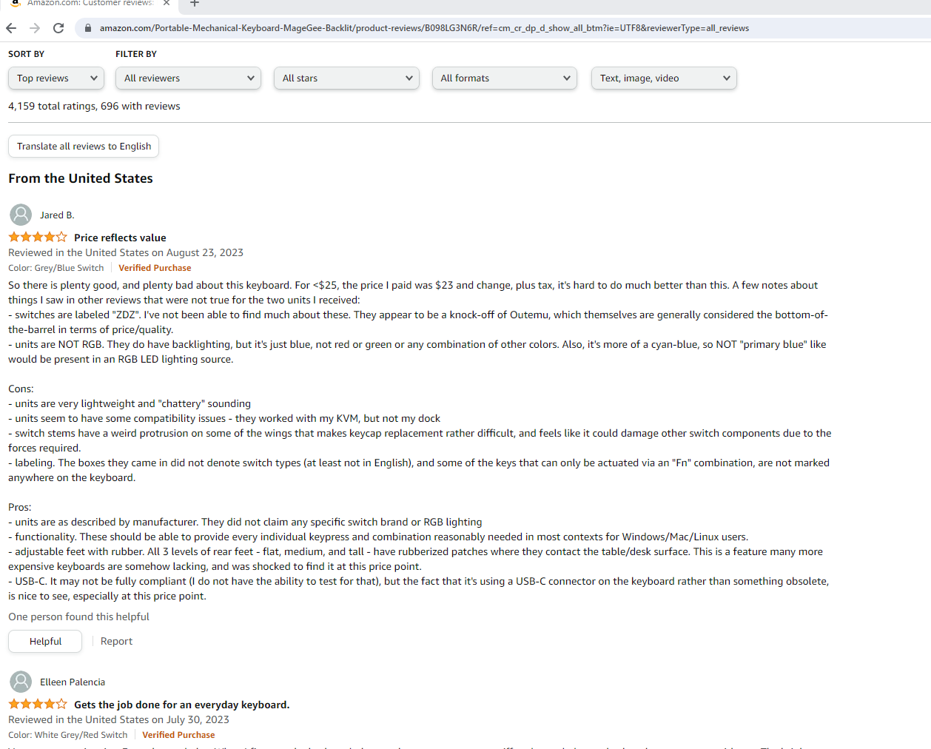









Data Collection from Reviews Page
After collecting information about the products from the search page, for Ech product we need to get the following information:
Profile Names.
Review Ratings.
Review Titles.
Review Content.

Slide 6
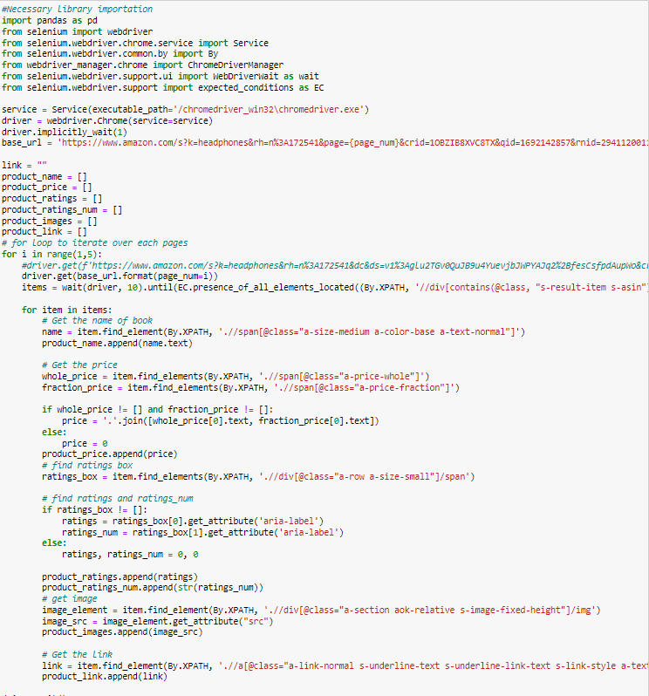
The Product search page

Slide 7
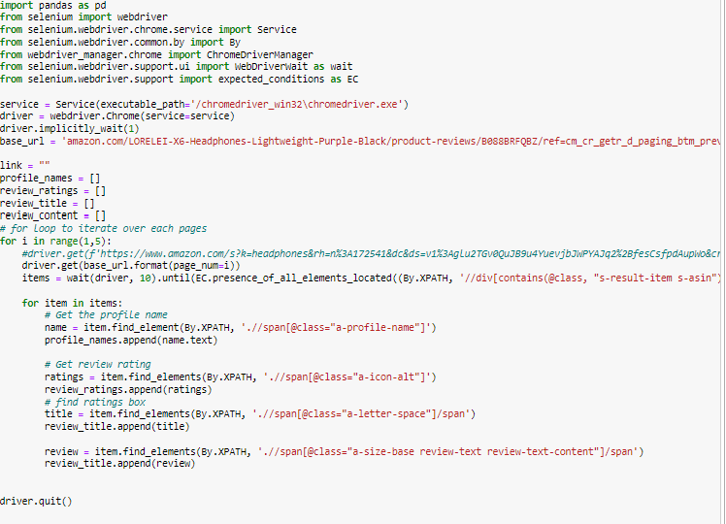
The Reviews Page

Slide 8
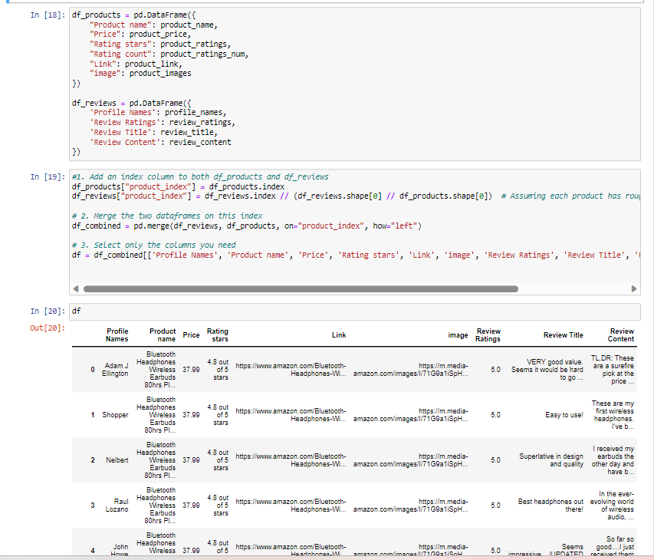
Combining Information from Both Scripts

Slide 9
Any challenges?
Challenges in Web Scraping on Amazon:
When I was collecting information from Amazon, I encountered some difficulties. Amazon has rules against web scraping, which means they don't want automated tools collecting data from their website. Here are the challenges I faced:
Scrapy Challenges: At first, I tried using a tool called Scrapy, but it didn't work very well. It needed a lot of resources, like a big engine for a small car.
Selenium Challenges: Then, I discovered Selenium, which worked better for me. However, it still had some challenges. For example, it required careful handling to avoid getting blocked by Amazon's anti-scraping measures. It was like trying to sneak past a guard to get what we needed.

Slide 10
Data Cleaning
some reviews, were in languages other than English, like Spanish or French. By using NLTK, I could easily separate the English reviews from the rest, making our dataset more focused.
perform some basic data cleaning operations to handle missing values and trim whitespace.

Slide 11
NLP Model
Sentiment Analysis using VADER
I used VADER (Valence Aware Dictionary and sentiment Reasoner) from NLTK to perform sentiment analysis on the reviews.
Then I used pre-trained RoBERTa-based model for sentiment analysis trained on ~58M tweets and finetuned for sentiment analysis with the TweetEval benchmark.

Slide 12
Creating a Flask Web App
Flask web application that serves as a product review platform. The application reads reviews for different types of products (mice, monitors, headphones, keyboards) from CSV files and stores them in an SQLite database. Users can filter the reviews based on specific product features they're interested in.
The code uses SQLAlchemy to perform case-insensitive LIKE queries to filter reviews.
Using Bootstrap 5 for styling, which helps in making the website responsive and visually appealing.

Slide 13
Results
Landing Page: When users first visit your web application, they will be greeted by this landing page, allowing them to select a product category (Mouse, Monitor, Headphone, Keyboard).

